Slide 1


Green Pace
Security Policy Presentation
Developer: Michael Perry Clisbee
Notes:
My name is Michael and today I am presenting the use of external testing methods to identify potential vulnerabilities by presenting the Green Pace security policy guide, and to provide implementation guidelines and recommendations for maintaining it in the future

Slide 2

OVERVIEW: DEFENSE IN DEPTH
Defense in Depth (DiD) is a cybersecurity concept that involves constructing layers upon integrated layers of defensive mechanisms to protect sensitive data and information, as seen in the chart below. The proposed security policy will break down how to apply this concept.
Notes:
Here we see the Defense in depth, which is a cybersecurity concept that involves constructing layers upon integrated layers of defensive mechanisms to protect sensitive data and information. For example: Multi-factor authentication. Multi-factor authentication is an electronic authentication method which grants a user access to an application application only after presenting two or more authentic pieces of evidence to an authentication mechanism: knowledge (something only the user knows), possession (something only the user has), and inherence (something only the user is).

Slide 3
THREATS MATRIX
Each Secure Coding
standard has
different
levels of
Threat severity to
measure the
Remediation cost of that
standard. Here
is a chart to
prioritize those
levels.
Likely SQL Injection Namespace Modifications Memory Protection | Priority Value Inputs
Low priority Data Type | Unlikely Data Values String Correctness Assertions Exceptions Input Output
Notes:
The Security threat matrix can be divided into four sections as seen in this matrix. We have the likely, priority, low priority and unlikely. Like is the loss of confidential information. Priority is when the system goes down, those will be the first things to get back up. Low priority is where there is inadequate exception handling. Unlikely covers Loss of integrity.

Slide 4
10 PRINCIPLES
1. Validate Input Data (Data Type)
2. Heed Compiler Warnings (Data Value)
3. Architect and Design for Security Policies. (String Correctness)
4. Keep it Simple (SQL Injection)
5. Default Deny (memory Protections)
6. Adhere to the Principle of Least Privilege (Assertions)
7. Sanitize Data Sent to Other Systems (exceptions)
8. Practice Defense in Depth (Input Output)
9. Use Effective Quality Assurance Techniques (Namespace Modifications)
10. Adopt a Secure Coding Standard (Value Inputs)
Notes:
In this slide, we will identify the 10 different types of security principles.
• Validate Input Data - Obey the one-definition rule
• Heed Compiler Warnings - Do not cast to an out-of-range enumeration value
• Architect and Design for Security Policies - Do not attempt to create a std::string from a null pointer
• Keep It Simple - Be careful using functions that use file names for identification
• Default Deny - Use a static assertion to test the value of a constant expression
• Adhere to the Principle of Least Privilege
• Sanitize Data Sent to Other Systems
• Practice Defense in Depth
• Use Effective Quality Assurance Techniques
• Adopt a Secure Coding Standard - Handle all exceptions

Slide 5
CODING STANDARDS
1. Data Type: Allow only enumeration values within specified parameters
2. Data Value: Define identifiers and valid references and pointers correctly to reduce likelihood of identifiers not defining
3. String Correctness: Never qualify a reference type with and const as it will result in undefined behavior.
4. SQL Injection: Do not store already owned pointer value in an unrelated smart pointer
5. Memory Protection: Properly De-allocate allocated resources
6. Assertions: Use static assertion to test value of a constant expression
7. Exceptions: Handle all exceptions thrown before main() executes
8. Input Output: Have a positioning call when alternating output and input from a file stream
9. Namespace Modifications: Do not modify standard namespaces. New declarations in the namespace can cause undefined behavior
10. Value Inputs: Value returning functions must return a value from all code paths
Notes:
We have different coding standards. Below are the 10 coding standards.
Data Type - Obey the one-definition rule
Data Value - Do not cast to an out-of-range enumeration value
String Correctness - Do not attempt to create a std::string from a null pointer
SQL Injection
Memory Protection - Do not call a deallocation function on anything other than nullptr
Assertions - Use a static assertion to test the value of a constant expression
Exceptions - Handle all exceptions
Input Output - Be careful using functions that use file names for identification
Namespace Modifications: Do not modify standard namespaces. New declarations in the namespace can cause undefined behavior
Value Inputs: Value returning functions must return a value from all code paths

Slide 6
ENCRYPTION POLICIES
Encryption in rest - Encryption for data at rest involves securely encoding data as it is written into storage and decrypting that data as it is pulled from storage for use. Using an encryption key when the data is written into storage protects it from unauthorized access. It should be used for all data of any level of sensitivity and would cause harm if accessed by unauthorized actors.
Encryption at Flight - Encryption of data at-flight involves securely encoding data as it is being transmitted. How you will be transferring any data will determine how to apply this encryption. Implement secure protocols when using web browsers. When sending emails encrypt before sending and use digital signatures.
Encryption in Use - Encryption of data in-use involves protecting data as it is utilized in memory, via password protected profiles protecting the memory of each profile
Notes:
I am now going to define different types of encryption policies.
Encryption in rest - Encryption for data at rest involves securely encoding data as it is written into storage and decrypting that data as it is pulled from storage for use. Using an encryption key when the data is written into storage protects it from unauthorized access. It should be used for all data of any level of sensitivity and would cause harm if accessed by unauthorized actors.
Encryption at Flight - Encryption of data at-flight involves securely encoding data as it is being transmitted. How you will be transferring any data will determine how to apply this encryption. Implement secure protocols when using web browsers. When sending emails encrypt before sending and use digital signatures.
Encryption in Use - Encryption of data in-use involves protecting data as it is utilized in memory, via password protected profiles protecting the memory of each profile

Slide 7
TRIPLE-A POLICIES
• Authentication - This process used to prove who a user is, their user ID, passwords, higher-level security such as secure tokens, CAC or PIN and other dual authentication.
• Authorization - Once a user is authenticated and allowed access, they are only granted specific access to parts of that system. Authorized access to certain drives, folders, programs, and other data is allowed by the system administrators
• Accounting - After authentication and authorization, you need to monitor and record
Notes:
Now we will summarize the Triple-A policies that support authentication:
• Authentication - This process used to prove who a user is, their user ID, passwords, higher-level security such as secure tokens, CAC or PIN and other dual authentication.
• Authorization - Once a user is authenticated and allowed access, they are only granted specific access to parts of that system. Authorized access to certain drives, folders, programs, and other data is allowed by the system administrators
• Accounting - After authentication and authorization, you need to monitor and record

Slide 8
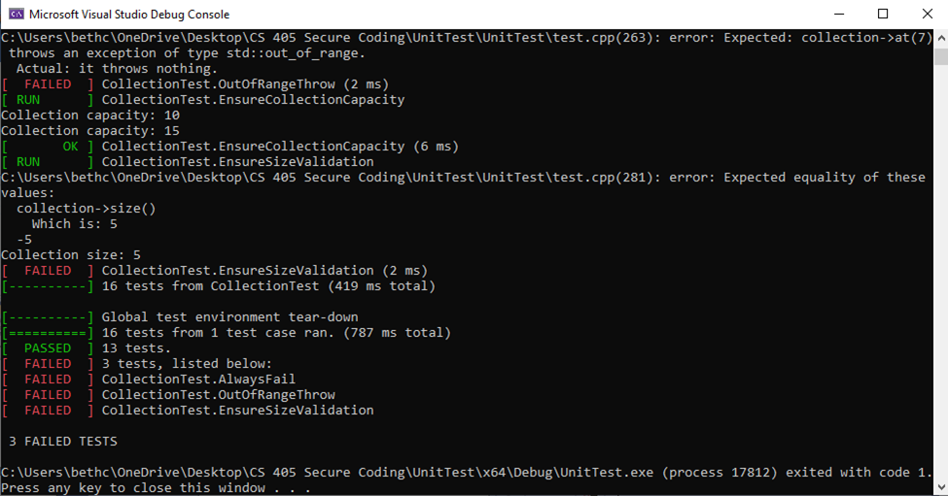
Unit Testing
13 unit tests were created using the Google unit testing framework. All test names reflect the purpose of the test. As well, Google ASSERT and EXCEPT were used as opposed to C++ assert / static_assert. Several of the tests brought back a negative result, or a failed test, and several brought back a positive result- passed- showing that the functionality works when tested.
Notes:
The diagram here shows the results of 13 unit tests which include google ASSERT and EXCEPT, bringing back a mix of negative and positive results. These were created using the Google Unit Testing Framework.

Slide 9

AUTOMATION SUMMARY
Notes:
Here we have a diagram of the automation summary, also known as the DevSecOps pipeline.

Slide 10
TOOLS
The DevSecOps pipeline is a secure coding method that has a continuous delivery using the security-focused software development life cycle (SDLC). This is a solid structure for the system, that goes through 6 segments to include Planning, Coding, Testing, Building, Release and Deployment. Ensure you are testing early and often to detect any flaws and resolve them before time of release.
Application tool: DAST: Dynamic Application Security Tool. This analyzes applications while they run, breaks encryption from the outside and verifies permissions.
Notes:
The DevSecOps pipeline is a secure coding method that has a continuous delivery using the security-focused software development life cycle (SDLC). This is a solid structure for the system, that goes through 6 segments to include Planning, Coding, Testing, Building, Release and Deployment. Ensure you are testing early and often to detect any flaws and resolve them before time of release.
One effective Application tool is called DAST: which stands for Dynamic Application Security Tool. This analyzes applications while they run, breaks encryption algorithms from the outside and verifies permissions.

Slide 11
RISKS AND BENEFITS
There is no such thing as 100% secure code but adopting secure coding practices removes common vulnerabilities. As well, priming your security policy at the start will reduce long term hazards and costs. Always remain vigilant in the assumption that all systems have implied threats and flaws to be identified. Continuous personnel training is essential in staying ahead of the issues that are ever evolving.
Notes:
There is no such thing as 100% secure code but adopting secure coding practices removes common vulnerabilities. As well, priming your security policy at the start will reduce long term hazards and costs. Always remain vigilant in the assumption that all systems have implied threats and flaws to be identified. Continuous personnel training is essential in staying ahead of the issues that are ever evolving.

Slide 12
RECOMMENDATIONS
All security policies can contain gaps. The key is to identify all possible avenues of attack approach and use that as you baseline for security creation.
Test defenses before the breaches occur and develop a plan to respond when security fails.
Notes:
All security policies can contain gaps. The key is to identify all possible avenues of attack approach and use that as you baseline for security creation.
All standards should be adopted to prevent future problems. Test defenses before the breaches occur and develop a plan to respond when security fails.
An example of gaps in an existing security policy took place in 2012 and made the news because it impacted over 167 million user accounts that were still actively being used with the users unaware of the intrusion.
Hackers cracked over 167 million user accounts, stealing over 117 million email accounts and passwords. It was only discovered when the hackers posted the user accounts on a Russian password forum. This data was placed in a database that was passed around to various hacker networks who then attempted to sell the information for a minimal amount of money. Breach notification site researchers discovered this as well and contacted numerous victims to confirm that these were current passwords and emails still actively used. This was a combination of both security and data breaches. After the fact, it was pointed out that LinkedIn did not have sufficient security protocols in place.
Once it was verified that the breach was real, LinkedIn fixed the security vulnerability and instructed all users to reset their passwords. If any user account did not reset their passwords, the account was deactivated. LinkedIn initially offered protection tools such as email challenges and dual authentication protocols, but these were not enforced until after the fact.
What preventative measures could have been taken? Some lessons that were learned were that many users had the same password used over several active accounts, which made it easier for hackers to access more information.
Recommendations for improvement:
Scanning is the process of analyzing code to ensure that it is safeguarded from security vulnerabilities. This includes both manual and automated code
In the review phase: AppSec tools — such as SAST and DAST — are used to help developers address security vulnerabilities and bugs earlier in the software development life cycle.
During the Analyze phase, all of the collected data and metrics from the previous phases are reviewed to identify all of the security risks. Then, those risks are compiled into a list ranging from most to least severe
In addition, it may be beneficial to also track and manage the differences between the actual and target metric values. This helps to make informed data-driven decisions during the software development lifecycle.

Slide 13
CONCLUSIONS
• In conclusion, based on the principles and standards described in this presentation it can be determined All possible avenues of attack approach have been covered to create and maintain a secure and proficient program. A zero-trust policy will be implemented when it comes to internal and external data access throughout the company network, creating a situational awareness necessary to maintain security and privacy and to keep all sensitive information safe and secure.
Notes:
In conclusion, based on the principles and standards described in this presentation it can be determined that all possible avenues of attack approach have been covered to create and maintain a secure and proficient program. A zero-trust policy will be implemented when it comes to internal and external data access throughout the company network, creating a situational awareness necessary to maintain security and privacy and to keep all sensitive information safe and secure.
All the coding standards and security policies should be adopted to prevent future problems.

Slide 14
REFERENCES
Forcepoint (2022). Defense-in-Depth Defined. Retrieved from https://www.forcepoint.com/cyber-edu/defense-depth
Andy (2022). LinkedIn 2012 hack: What you need to know. Retrieved from https://www.ncsc.gov.uk/blog-post/linkedin-2012-hack-what-you-need-know
TrendMicro (2022). 2012 LinkedIn Breach had 117 Million Emails and Passwords Stolen. Retrieved from https://www.trendmicro.com/vinfo/us/security/news/cyber-attacks/2012-linkedin-breach-117-million-emails-and-passwords-stolen-not-6-5m
Notes:
Above are references if needed. Thank you for taking the time to read this

